Slide 1
House of God, Gateway to Heaven
Surely the Lord is in this place!
31/03/19
Notes:
Recap:
Themes –
2 Cor 13:14 Grace, love, Communion (grace to change…)
2019 Year of Increase, intimacy, immunity
The goal of intimacy – it’s a heart thing, a heart turn

Slide 2

Key Scriptures
2 Cor 13:14
The grace of the Lord Jesus Christ, and
The love of God, and
The communion of the Holy Spirit
be with you all.
Amen.
Notes:
This verse reveals our interaction with the Triune God. Let’s break this down

Slide 3
Key Scriptures
Gen 28:10 -17
Now Jacob went out from Beersheba and went toward Haran.
So he came to a certain place and stayed there all night, because the sun had set.
And he took one of the stones of that place and put it at his head, and he lay down in that place to sleep.

Slide 4
Key Scriptures
Gen 28:10 -17
12 Then he dreamed, and behold, a ladder was set up on the earth, and its top reached to heaven; and there the angels of God were ascending and descending on it.
13 And behold, the Lord stood above it and said: “I am the Lord God of Abraham your father and the God of Isaac; the land on which you lie I will give to you and your descendants.

Slide 5
Key Scriptures
Gen 28:10 -17
14 Also your descendants shall be as the dust of the earth; you shall spread abroad to the west and the east, to the north and the south; and in you and in your seed all the families of the earth shall be blessed.
15 Behold, I am with you and will keep you wherever you go, and will bring you back to this land; for I will not leave you until I have done what I have spoken to you.”

Slide 6
Key Scriptures
Gen 28:10 -17
16 Then Jacob awoke from his sleep and said, “Surely the Lord is in this place, and I did not know it.”
17 And he was afraid and said, “How awesome is this place! This is none other than the house of God, and this is the gate of heaven!”

Slide 7
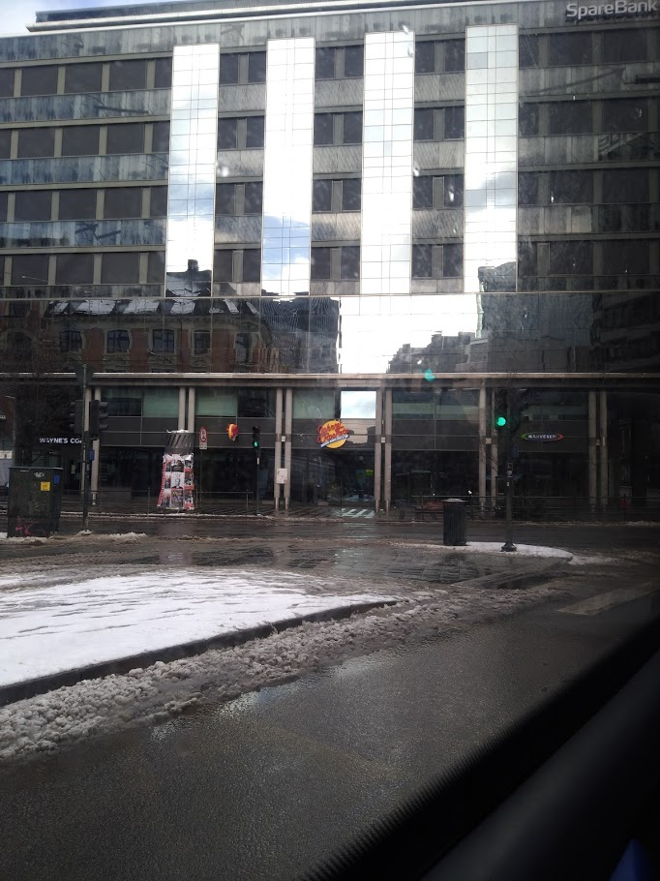
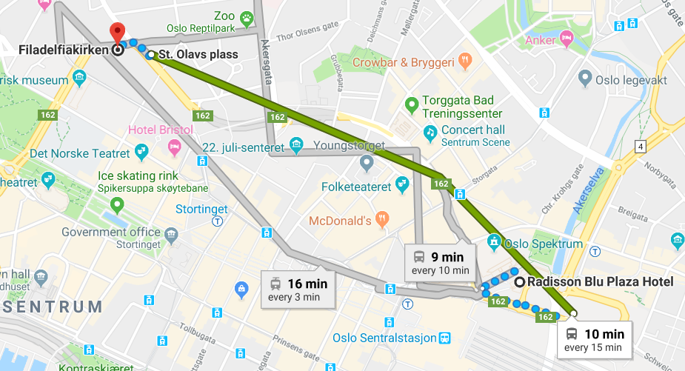
Finding my way around…

Slide 8
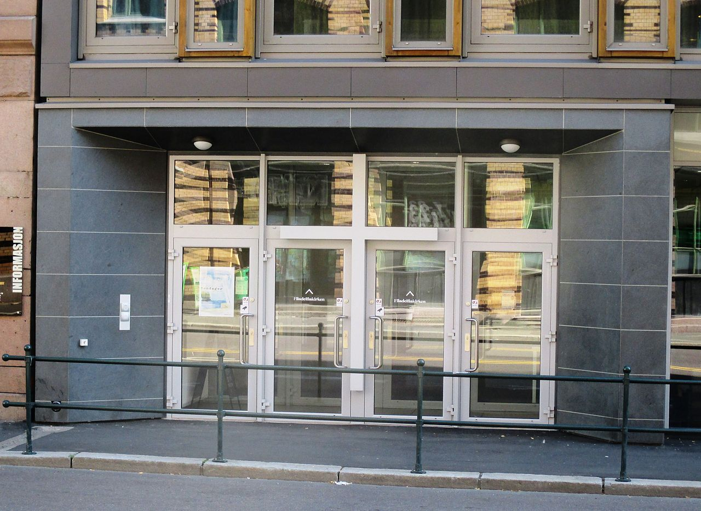
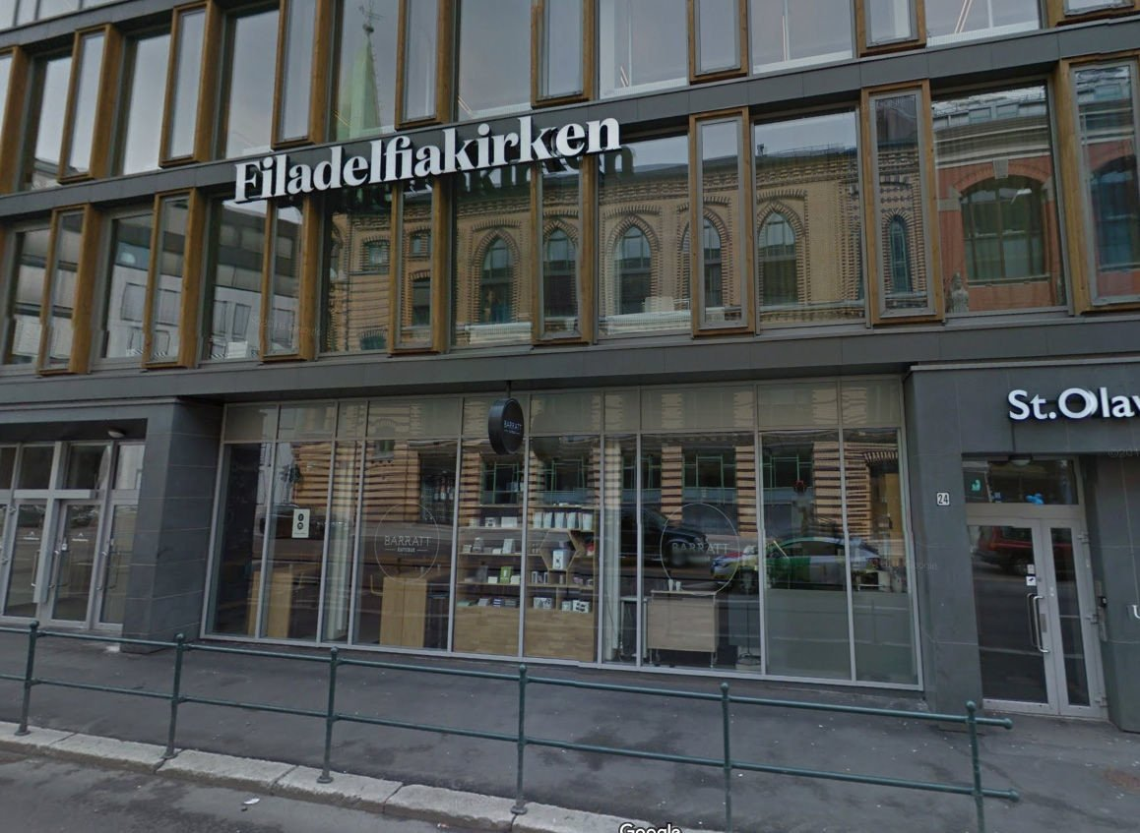
Trying to find the door

Slide 9
The traps we fall into
Over-reliance on human / natural ways Trusting in things other than God - Google maps (1 Cor 3:19)
Over-thinking and over-analysing
Trying to find my own solutions or fix things myself instead of trusting God
Over-planning
Prov 16:9, Prov 19:21
Notes:
1 Cor 3:19 “the wisdom of this world is foolishness with God…”
Prov 16:9 “The heart of man plans his way, but the Lord establishes his steps.”
Prov 19:21 Many are the plans in the minds of a man, but it is the purpose of the Lord that will stand”

Slide 10

Surely the Lord is here and I did not know it
How could Jacob not know that the Lord was there?
Busy living our own lives
Doing our own things
Making our own plans
Mind is filled with our own thoughts

Slide 11
Surely the Lord is here and I did not know it
v13 And behold, the Lord stood above it…
The sign was visible once I looked up
The door (the answer / Jesus) was right in front of me and I could not see it
Luke 24:31-32 “Then their eyes were opened and they knew Him; and He vanished from their sight. And they said to one another, “Did not our heart burn within us while He talked with us on the road and while He opened the Scriptures to us?”

Slide 12

House of God, Gateway to Heaven
He wants to meet with us
It requires a heart change
It requires action – daily decisions

